Slide 1
A Course Advisor Expert System
Case Study-1

Slide 2
Abstract
In this case study, we will explain the the development of a knowledge-based expert system .
The system will be a program that chooses a customised postgraduate study program from existing and targeted sets of skills.
Presentison explains the problem domain followed by the concepts and requirements involved in the expert system design.All focus will be on the knowledge representation ,acquisition and rule base design processes .
Implementation and deployment are explained .

Slide 3
Introduction
This paper illustrates the problem through a case study describing the use of an expert system to customise the necessary study program for particular sets of existing- vs. targeted knowledge.
The system will offer guidance to potential students and to course designers about the necessary structure of a particular study program .
The case study is limited to an expert system prototype, dealing with postgraduate students with a non-IT background.

Slide 4
The Problem Domain
The existing Web-based University courseb description system presents a number of limitations.
Occasionally, erroneous or stale information is provided, which may lead to misleading students in their enrolments / exams .
In addition, the present system does not verify that a student may enrol in subjects in a way contradicting the University policies.
Finally, the present subject and course descriptions may be confusing for prospective students .

Slide 5
Developing the Expert System
In developing the expert system it is desirable to start with a prototype of the complete expert system. A prototype can assess the feasibility of a project without full financial or resource commitment and may then be submitted for evaluation to users / stakeholders to obtain their feedback and commitment.
User and host institution acceptance is a multidimensional aspect, which ultimately decides the usefulness of the entire system development effort.
The development; a particular subject enrolment order for a course of the prototype could not be left to the knowledge engineer alone,as it needs the knowledge elicitation from at least one domain expert .

Slide 6
Life Cycle Models for Development
Several life cycle paradigms have been considered, such as waterfall, incremental, linear, spiral, etc .
A modified spiral paradigm has been successfully adopted, observing some guidelines in adding new facts and rules, such as: maintain integrity (do not contradict the existing facts and rules), avoid redundancy (do not represent knowledge already existent in the rule base), prevent scattering the knowledge over an excessive amount of rules / facts, etc.
Thus, a balance must be struck between the facts’ and rules’ complexity, expressive power and number.

Slide 7
Concepts of the Expert System
The expert system is based on several concepts aiming to improve the subject selection and education processes.
These concepts are modularity of subjects, prerequisites and outcomes for subject modules and credit for previous studies.
Hence, the aim is to establish modules within the subjects, having their own prerequisites, outcomes and credit points awarded on completion. The granularity of (number of modules within) a subject must maintain a balance between flexibility and processing / development time required.

Slide 8
User Requirements for the Expert System Prototype
The user will provide a preferred type of occupation (targeted set of skills) and previous knowledge (potentially usable to satisfy some of the prerequisites for the modules composing the study program) as requested by the system.
The system will provide a study course to achieve the targeted occupation and may also suggest corrections if the user skills (as stated) are too limited or too high.

Slide 9
Design of the Expert System Prototype
* System Requirements The system requirements represent a translation of the user requirements into the system domain. For this particular case they may take the form:
the expert system must rely on the user’s tacit knowledge.
modules are seen as objects, having interfaces (in fact, its prerequisites and outcomes) contained in special lists, further contained within module facts.
a module prerequisite may be satisfied by at most one outcome, (either of another module, or declared as ’known’ by the user).
the consultation starts with a set of initial facts, asserted at run-time according to the user’s answers to ’job domain’ and ’job type’ queries. These facts provide the initial list of unsatisfied prerequisites.

Slide 10
Design of the Expert System Prototype
* System Requirements The system requirements represent a translation of the user requirements into the system domain. For this particular case they may take the form:
5. the system attempts to match these unsatisfied prerequisites (first against outcomes eclared ’known’ by the user, and if unsuccessful, against the ’out- comes’ lists of the other module facts in the knowledge base.
6. when a matching outcome is found for a prerequisite, the module owning the outcome is marked as ’needed’ and its prerequisites list is then in its turn scanned for matches with other outcomes. The prerequisite for which the match has been found is marked ’done’.
7. any prerequisites found not to be either declared ’known’ by the user, or not already satisfied by other modules’out comes will trigger additional questions for the user.

Slide 11
Design of the Expert System Prototype
* System Requirements The system requirements represent a translation of the user requirements into the system domain. For this particular case they may take the form:
8. according to the user’s answers, prerequisites are either marked ’known’ (user already has the required skill), or added to the unsatisfied prerequisites list,
9. the process is repeated until all prerequisites are satisfied - either by other modules’ outcomes (’done’) or by previous skills of the user (’known’).
10. the list of all modules marked as ’needed’ (that the user will need to enroll in) is printed out10. Note that some special modules (e.g. project) are automatically added, regard less of the user’s prior knowledge.

Slide 12
Knowledge Representation and Method of Inference
Design decisions had to be made regarding the formalism to be used in representing the knowledge contained in the teaching system.
The type of knowledge to be represented (namely components of the various courses composing current study programs) matched the form of a collection of isolated facts, rather than a structured set of knowledge or a concise theory.
Therefore, rules / assertions were preferred to frames or algorithms in a first decision round . Production rules have been chosen in preference to logic and semantic nets / frames for being more suitable for solving design and planning problems.Bottom-up reasoning / inference was decided upon, whereby a starting fact set (provided by the user) is matched against the conditions of the production rules in the rule base (constructed upon the policies governing the University study programs). Bottom-up inference has led to forward chaining.

Slide 13
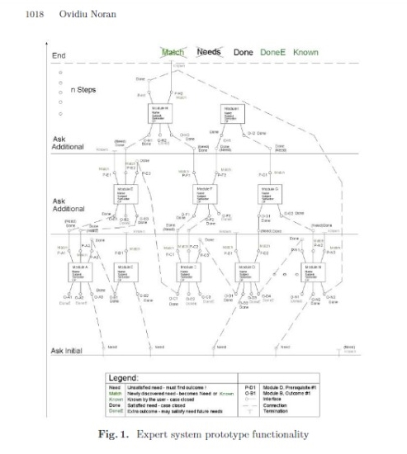
System functionality is shown diagrammatically in Fig.1.

Slide 14
Knowledge Acquisition
The knowledge acquisition methods chosen for the prototype have been the questionnaire and structured interview. This decision owes to several factors, such as prototype size, nature of the problem domain and availability of domain experts.
Questionnaires are well suited to future automated processing, which benefit the knowledge acquisition process.
The questionnaire and interview designs have acknowledged the gap between the descriptions of domain specialists (subject conveners) and the resulting computational models and the social issues underlying knowledge creation. The interview design has loosely followed the COMPASS procedure.

Slide 15
Design Constraints
* Constraints are necessary in order to enable a fifinite solution to be produced. Examples:
The outcomes of a module must be distinct.
Two modules may not produce the same outcome: doing so would produce a redundancy in the teaching structure which needs to be resolved.
All the module prerequisites contained in the knowledge base are satisfied by outcomes of other modules in the base.
Nil prerequisites for modules are allowed;so, they still require basic graduate knowledge, such as maths, physics, etc (the tacit knowledge).
Cyclic dependencies between any two modules are disallowed (e.g. if module (A) has a prerequisite satisfied by module (B), module (B) must not have a prerequisite satisfied only by module (A) ).
Maximum number of year n modules: may conflict with the concept of a Conversion Course and limit the flexibility of the expert system .
Maximum number of modules per Semester ,In real life, subjects tend to be equally distributed in all Semesters.
balanced number of modules in each Semester.

Slide 16
The Expert System Conceptual Model
The knowledge base should contain facts and rules referring to the prerequisites and outcomes of modules of the subjects offered in the University.
The facts are either ’fixed’ (such as the modules information) or run-time asserted (e.g. the user’s answers to the expert systems’ questions). The inference engine must be chosen to match previous requirements and design decisions.
The user interface, preferably graphical and integratable with currently and commonly used operating systems and enabling technology infrastructure (e.g. Internet), would preferably be implemented in the same language as the inference engine.

Slide 17
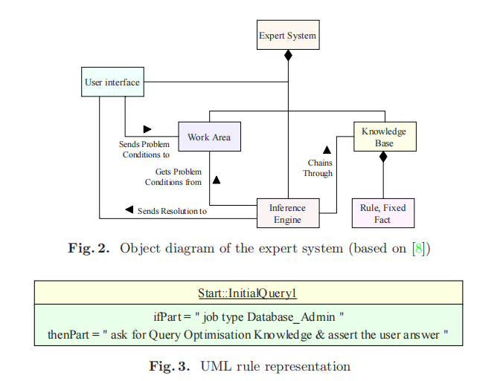
The Knowledge Base In an UML representation
A Unified Modelling Language (UML) model of the expert system is presented in Fig. 2. In this figure, the user-expert system interaction occurs through the user interface, which sends the problem conditions (answers to questions) to the work area that holds all the temporary data. The inference engine uses the knowledge base for the rules and fixed facts, and the work area for the dynamicfacts (asserted at run-time). The solution is delivered to the user interface.

Slide 18
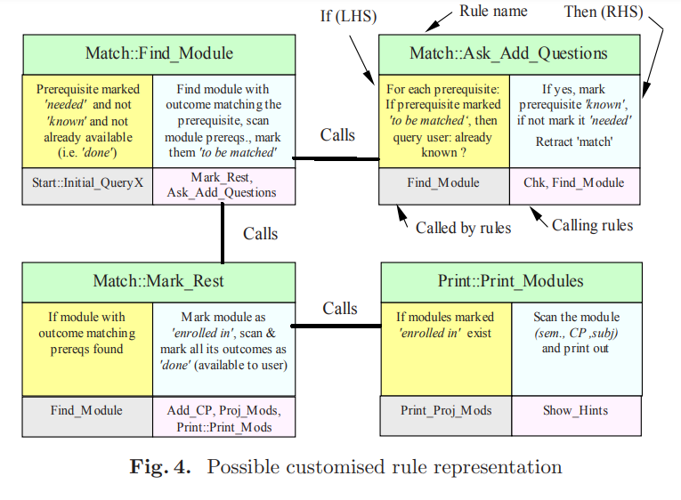
Implementation
The virtual machine hierarchy as described in provides a good guide towards the expert system prototype implementation. Several web-enabled expert system .

Slide 19
Shells for expert systems
Shells have been considered for the specific problem domain.
The shell has to be matched to the task in order to assist in the knowledge representation exercise. Most shells impose a particular production rule formalism, chaining and structure17 to the rule set.
Considering the size of the prototype, the resources available and the problem domain, the choice has been an expert system shell written in Java (JESS - The Java Expert System Shell), emulating the CLIPS language, with a simple pre-made graphical user interface. This solution provides the power of the CLIPS language and the flexibility of the Java cross-platform concept.
Although the Java AWT (Abstract Window Toolkit) is available in JESS, JConsult has been preferred as an off-the-shelf basic JESS graphical user interface. The inference engine is indirectly provided by CLIPS. The CLIPS language uses forward-chaining and the RETE fast pattern-matching algorithm.

Slide 20
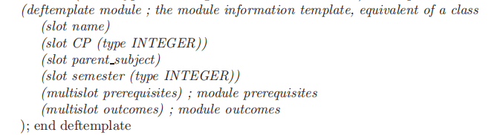
The Knowledge Base Implementation
JESS, similar to CLIPS (and LISP),uses the list construct to hold the data. The facts may be asserted manually (i.e. hardcoded in the knowledge base) or at run-time. They are implemented as listscontaining one or more other lists. Example:
(attribute (type job)(value ”Database Administrator”)).
Templates are similar to classes and contain models for the facts.Three typesof templates have been used:
goal (a special type of fact, used to initialize the expert system).
attribute (a general purpose fact consisting of a type and a value).
module (a fact type describing the module information).
Example:

Slide 21
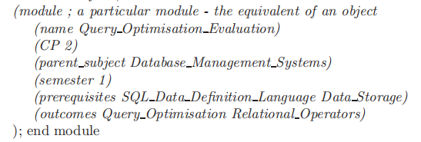
The Knowledge Base Implementation
A slot declares a field within the template - actually, a list in itself. A multislot declares a multifield a list with more than two members. For example:

Slide 22
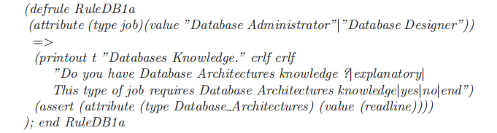
The rules in the JESS
This is a module object example where the prerequisites and outcomes list both have more than two members. In this way, a variable number of members may be accomodated within a list without any special requirements.
The rules in the JESS environment take the form if-part => then-part:

Slide 23
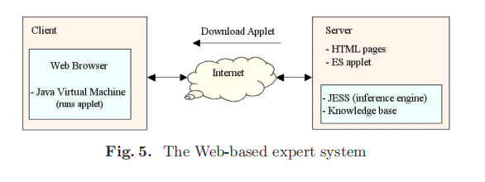
Testing / Verification: Running a Consultation
The system will initially require a target domain and specific employment opportunity (within the chosen domain); this will create the first set of modules needed.
The system will then query the user on previous knowledge usable to satisfy the prerequisites of this first set of modules.
The system will seek appropriate modules whose outcomes satisfy the prerequisites in question.
The majority of modules in the knowledge base have non-nil prerequisites.
The system will seek to satisfy all the prerequisites of a module before enrolling the user in that module.

Slide 24
Testing / Verification: Running a Consultation
The system analyzes the requirement that is entered and then asks the user whether he has knowledge of this requirement, if the answer is not chosen, the appropriate response from outcomes.
At the end of the consultation, the expert system will produce an output containing: Stated (existing) knowledge, Necessary modules with Parent Subject, Semester, Credit Points, Project modules (the Conversion Course must include a 40CP Project) and Total Credit Points necessary for the course18. Boundary values are as follows: needed CP < 70 - existing knowledge may be overstated; 70 < CP < 105 - Ok.; 105 < CP < 150 - existing knowledge may have been understated; CP> 150: the envisaged occupation / skills may be unsuitable for that person (previous knowledge too limited).
A sample run of the expert system for the job of ’Artificial Intelligence Re_searcher’ (with prior knowledge) has produced the output shown partially in Fig.6.

Slide 25
Deployment
Figure 5 shows the current method of deployment of the prototype, which was deemed appropriate for the restricted initial scope of the problem domain.
in a customised Course, the number of total credit points depends on the student’sprior knowledge. the algorithm for that kind of function involves careful subject planning and furtherknowledge elicitation.at the time of writing, the expert system prototype is available for evaluation on http://www.cit.gu.edu.au/~noran

Slide 26
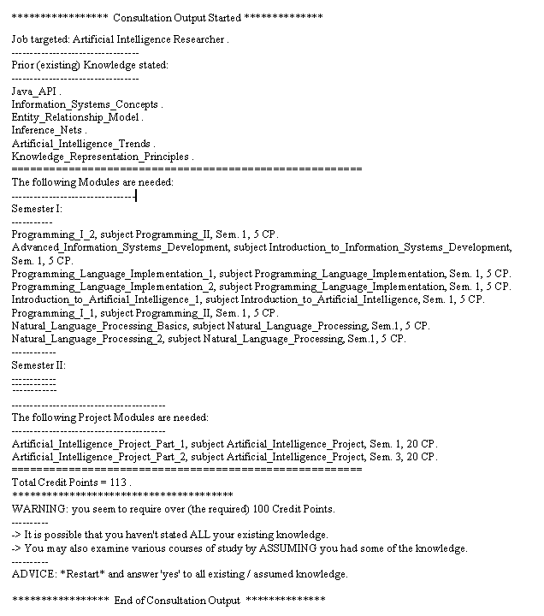
Fig. 6. Extract from the Expert system output

Slide 27
Maintenance / Modification
Deployment is not the end of the spiral development paradigm.
In fact, another spiral, comprising periodic maintenance and updating will be necessary to keep the knowledge base current.
All additions / modifications must preserve the currently applicable knowledge base constraints and be properly validated.
Specialised maintenance constraints and querying the reasoning of the expert system must also be available to the knowledge engineer.

Slide 28
Further Work on the Prototype and Beyond
Knowledge acquisition has proved to be the major bottleneck in this case study.Thus, the knowledge elicitation techniques will need to be improved, so as to shorten the knowledge acquisition turn-around time (on-line questionnaires, and automated assessment and knowledge base input).Interview techniques should be selected to support this automation.Low-level automated knowledge acquisition may also be derived from CLIPS .
Substantial improvements may be made in the user interface. Also, an algorithm could be implemented to evenly distribute the modules by the semester they are offered in, together with a mechanism to limit the number of modulesper semester (or else extend the study period).
The download time of the current expert system implementation could also be shortened by shifting data / input processing on the server side, using servlets(with user-program interaction occurring either via HTML pages containing FORM requests, or through applet / servlet interaction).
Although the presented prototype is reusable and scalable to a certain degree,a fully featured expert system may have different needs in terms of the set ofdevelopment and knowledge acquisition tools .

Slide 29
Conclusions
This case study has presented the application of an expert system to a non-trivial problem domain that involves producing a customised study program for post-graduate students with previous knowledge.
The design and implementation decisions have been highlighted and justified, and sample run results have been provided.
The development and testing of the prototype have validated the concept of a knowledge-based advisory expert system, provided that a set of essential guidelines are followed and due attention is paid to the knowledge acquisition process design and implementation.Further details on the design and implementation of this system .

